Slide 1
Chapter 2
Hardware Concepts:
Since a computer is an electronic machine, so without any input to a computer it doesn’t work anything.
Keyboard
Mouse
Light pen
Touch screen, and
Tablet

Slide 2
Input Hardware
Keyboard:
is a device primarily used for entering text string, i.e. keyboard is an efficient device for inputting non graphics data.
creates a code such as ASCII uniquely corresponding to a pressed key.
usually consists of alphanumeric keys, function keys, cursor-keys, and a separate numeric key pad.

Slide 3
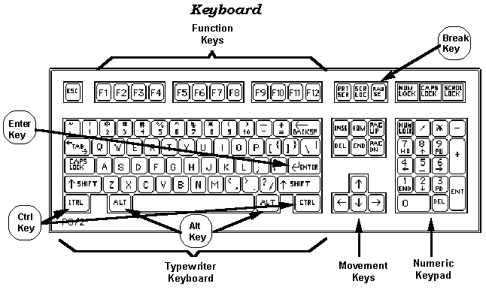
Input Hardware

Slide 4
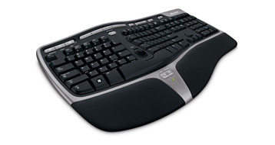
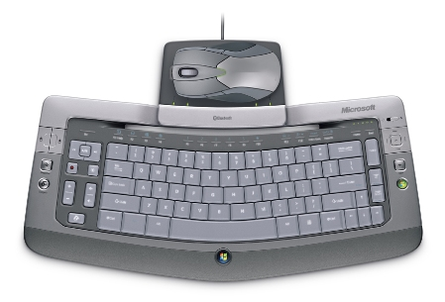
Input Hardware
Wireless keyboard
Ergonomic keyboard

Slide 5
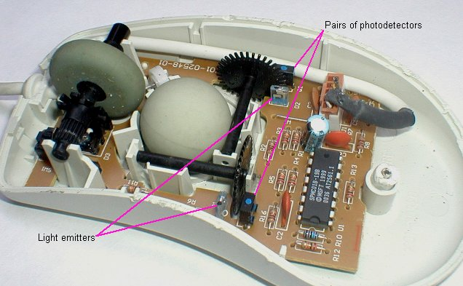
Input Hardware
Mouse:
Mouse is a small hand held device used to position the cursor on the screen.
A. Mechanical Mouse

Slide 6
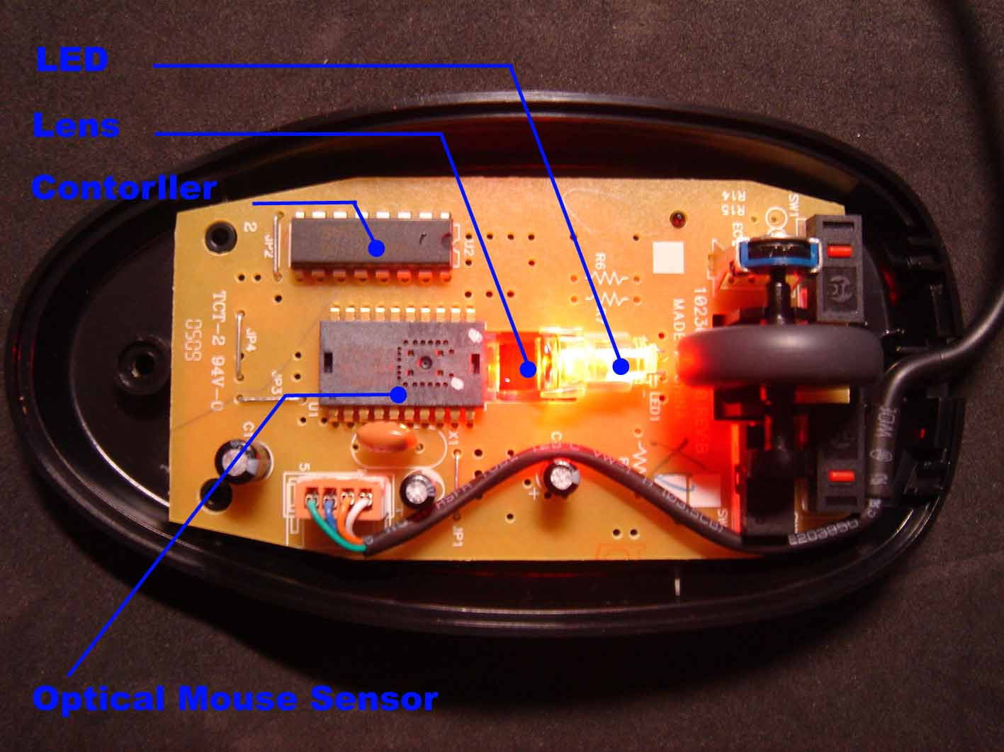
Input Hardware
B. Optical Mouse

Slide 7


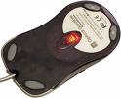
Input Hardware

Slide 8
Input Hardware
Tablet
Tablet is a digitizer.
- scan over an object and input a set of discrete coordinate positions.
These positions can then be joined with straight line segments to approximate the shape of the original object.
A tablet digitizes an object detecting the position of a movable stylus (a pencil shaped device) or a puck(a mouse like device with cross hairs for sighting positions) held in the user’s hand.

Slide 9
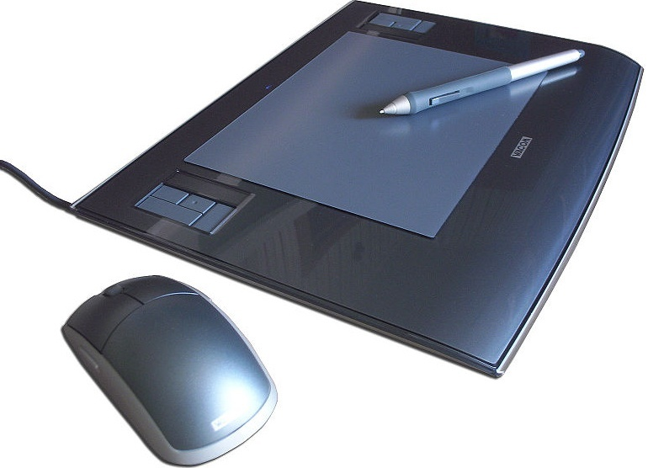
Input Hardware

Slide 10
Input Hardware
i. Electrical Tablet
A grid of wires on ¼ to ½ inch centers is embedded in the tablet surface.
Electromagnetic signals generated by electrical pulses applied in sequence to the wires in the grid induce an electrical signal in a wire coil in the stylus or puck
The strength of the signal induced by each pulse is used to determine the position of the stylus.
The signal strength is also used to determine roughly how far the stylus is from the tablet

Slide 11
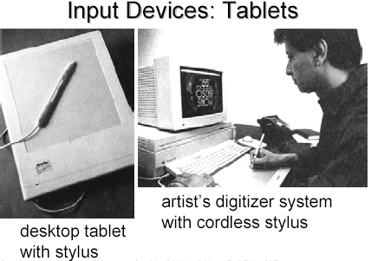
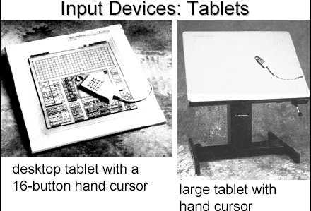

Slide 12
Input Hardware
ii. Sonic Tablet
The sonic tablet uses sound waves to couple the stylus to microphones positioned on the periphery of the digitizing area
An electrical spark at the tip of the stylus creates sound bursts.
The position of the stylus or the coordinate values is calculated using the delay between when the spark occurs and when its sound arrives at each microphone

Slide 13
Input Hardware
The main advantage of sonic tablet is that it doesn’t require a dedicated working area as the microphones can be placed on any surface to form the tablet work area
This facilitates digitizing drawing on thick books because in an electrical tablet this is not convenient for the stylus can not get closer to the tablet surface

Slide 14
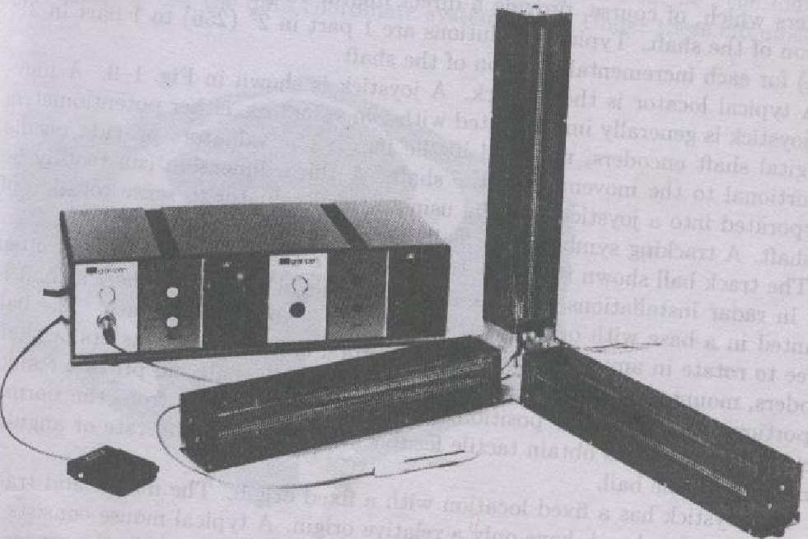

Slide 15
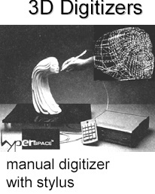

Slide 16
Input Hardware
iii. Resistive Tablet
The tablet is just a piece of glass coated with a thin layer of conducting material
When a battery powered stylus is activated at certain position it emits high frequency radio signals which induces the radio signals on conducting layer.
The strength of the signal received at the edges of the tablet is used to calculate the position of the stylus

Slide 17
Input Hardware
Several types of tablets are transparent, and thus can be backlit for digitizing x-ray films and photographic negatives.
The Resistive tablet can be used to digitize the objects on CRT because it can be curved to the shape of the CRT.
The mechanism used in the electrical or sonic tablets can also be used to digitize the 3D objects

Slide 18
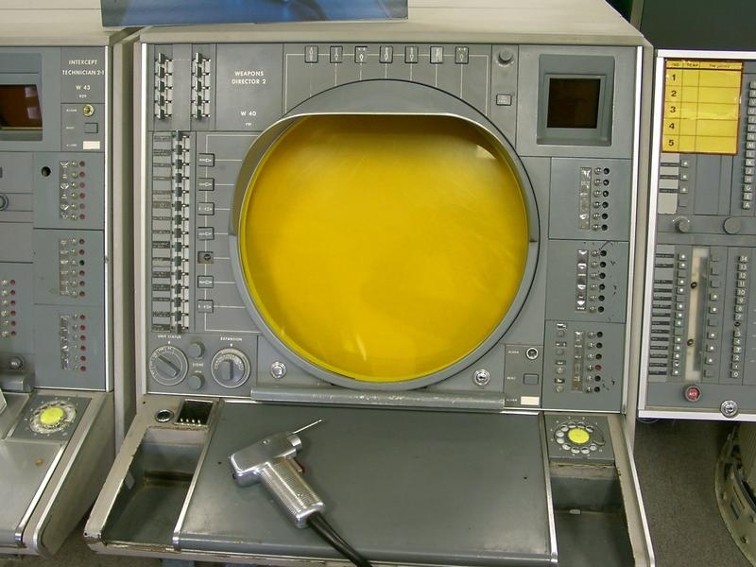
COMPUTER GRAPHICS

Slide 19

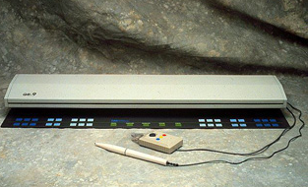
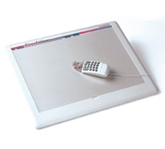
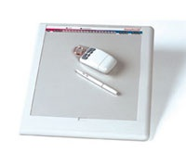
COMPUTER GRAPHICS
Puck
Stylus
Electrical Tablet

Slide 20
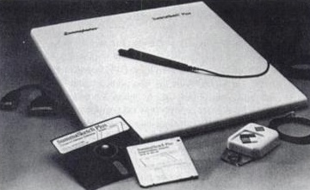
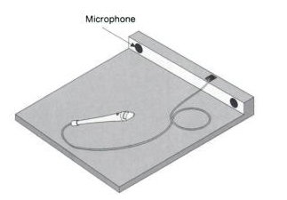
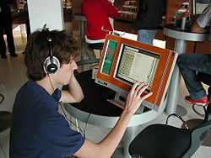
COMPUTER GRAPHICS
Types:
Electrical Tablet

Slide 21
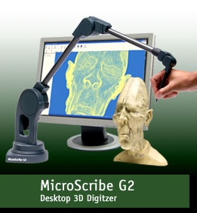
COMPUTER GRAPHICS

Slide 22
Input Hardware
Touch Panels
The touch panel allows the user to point at the screen directly with a finger to move the cursor around the screen or to select the icons.
i. Optical Touch Panel
It uses a series of infrared light emitting diodes (LED) along one vertical edge and along one horizontal edge of the panel
The opposite vertical and horizontal edges contain photo detectors to form a grid of invisible infrared light beams over the display area.

Slide 23
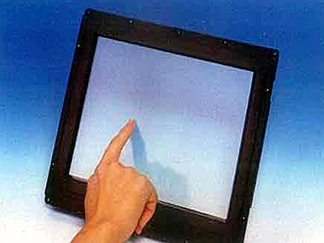
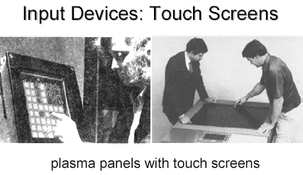
Input Hardware
Touching the screen breaks one or two vertical and horizontal light beams thereby indicating the fingers position
The cursor is then moved to this position or the icon at this position is selected
This is a low resolution panel which offers 10 to 50 positions in each direction

Slide 24
Input Hardware
ii. Sonic Touch Panel
Bursts of high frequency sound waves traveling alternately horizontally and vertically are generated at the edge of the panel .
Touching the screen causes part of each wave to be reflected back to its source
The screen position at the point of contact is then calculated using the time elapsed between when the wave is emitted and when it arrives back at the source
This is a high resolution touch panel having about 500 positions in each direction

Slide 25
Input Hardware
iii. Electrical Touch Panel
It consists of slightly separated two transparent panel one coated with a thin layer of conducting material and the other with resistive material
When the panel is touched with a finger the two plates are forced to touch at the point of contact thereby creating the voltage drop across the resistive plate which is then used to calculate the coordinate of the touched position
The resolution of the touch panel is similar to that of sonic touch panel

Slide 26
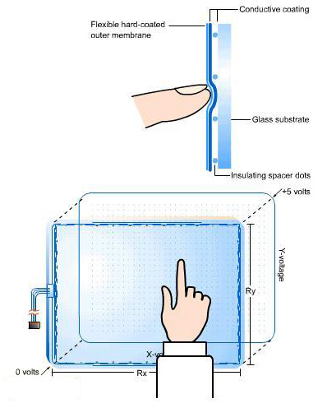
Input Hardware

Slide 27
Input Hardware
Light pen
It is a pencil shaped device to determine the coordinates of a point on the screen where it is activated such as pressing the button .
In raster display ‘y’ is set at y_{max} and ‘x’ changes from 0 to x_{max} the first scan line .
For the second line ‘y’ decreases by one and ‘x’ again changes from 0 to x_{max} and so on
When activated light pen sees a burst of light at certain position as the electron beam hits the phosphor coating at that position it generates an electric pulse

Slide 28
Input Hardware
This is used to save the video controller’s ‘x’ and ‘y’ registers and interrupt the computer
By reading the saved valued the graphics package can determine the coordinates of the position seen by the light pen
Drawbacks
i. Light pen obscures screen images as it is pointed to required spot
ii. Prolong use of it can cause arm fatigue
iii. It cannot report the coordinates of a point that is completely black as a remedy one can display a dark blue field in place of the regular image for a single frame time
iv. It gives sometimes false reading due to background lighting in a room

Slide 29
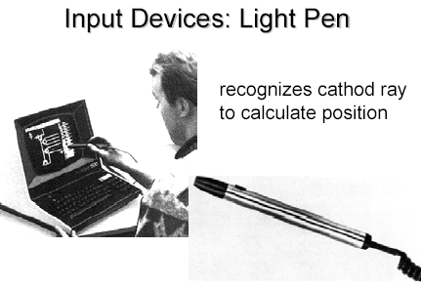

Slide 30
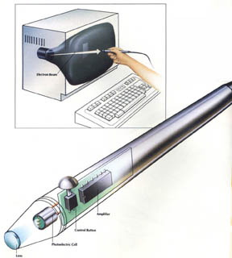

Slide 31
Display Devices
Fluorescence / Phosphorescence
A phosphors fluorescence is the light emitted as the very unstable electrons lose their excess energy while the phosphor is being struck by electrons
Phosphorescence is the light given off by the return of the relatively more stable excited electrons to their unexcited state once the electron beam excitation is removed

Slide 32
Display Devices
Persistence
A phosphor’s persistence is defined as the time from the removal of excitation to the moment when phosphorescence has decay to 10 percent of the initial light output
The range of persistence of different phosphors can reach many seconds
The phosphors used for graphics display devices usually have persistence of 10 to 60 micro seconds
A phosphor with low persistence is useful for animation and a high persistence phosphor is useful to highly complex static pictures

Slide 33
Display Devices
Refresh rate
The refresh rate is the number of times per second the image is redrawn to give a feeling of un-flickering pictures and it is usually 50 per second
As the refresh rate decreases flicker develops because the eye can no longer integrate the individual light impulses coming from a pixel
The refresh rate above which a picture stops flickering and fuses into a steady image is called the critical fusion frequency (CFF)

Slide 34
Display Devices
The factors affecting the CFF are:
i. Persistence: longer the persistence the lower the CFF But the relation between the CFF and persistence is non linear
ii. Image intensity: Increasing the image intensity increases the CFF with non linear relationship
iii. Ambient room light: Decreasing the ambient room light increases the CFF with nonlinear relationship
iv. Wave lengths of emitted light
v. Observer

Slide 35
Refresh rate
When electron beam strikes a dot in CRT, the surface of the CRT only glows for a fraction of a second and then fades.
Monitor must redraw the picture many times per second to avoid having the screen flicker

Slide 36
Refresh rate
The refresh rate is the number of times per second that monitor redraws the images on the screen.
Very few people notice flicker at refresh rates above 72 Hz.
Higher refresh rates are preferred for better comfort in viewing the monitor

Slide 37

Display Devices
Resolution
Resolution is defined as the maximum number of points that can be displayed horizontally and vertically with out overlap on a display device
Factors affecting the resolution are as follows
i. Spot profile:
The spot intensity has a Gaussian distribution. So two adjacent spots on the display device appear distinct as long as their separation D₂ is greater than the diameter of the spot D₁ at which each spot has an intensity of about 60 percent of that at the center of the spot
Intensity 60%
D₁
D₂

Slide 38
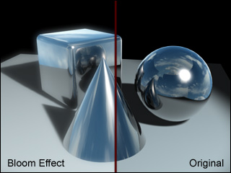
Display Devices
Intensity:
As the intensity of the electron beam increases the spot size on the display tends to increase because of spreading of energy beyond the point of bombardment
This phenomenon is called blooming. Consequently , the resolution decreases.
Thus it is noted that resolution is no necessarily a constant and it is not necessarily equal to the resolution of a pix-map, which is allocated in a buffer memory

Slide 39
i. Vector Display Technology
CPU
Peripheral Devices
System Bus
System Memory
Display Processor
Monitor
Display List ->
.
.
MoveTo(10,10)
LineTo(639,479)
.
.
.

Slide 40
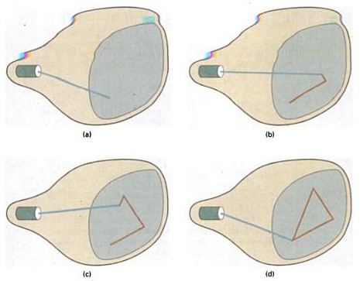
i. Vector Display Technology

Slide 41
i. Vector Display Technology
It is also called random scan, a stroke, a line drawing or calligraphic display
Advantages:
i. It can produce a smooth output primitives with higher resolution unlike the raster display technology
ii. It is better than raster display for real time dynamics such as animation
iii. For transformation, only the end points has to be moved to the new position in vector display but in raster display it is necessary to move those end points and at the same time all the pixels between the end points must be scan converted using appropriate algorithm
No prior information on pixels can be reused

Slide 42
i. Vector Display Technology
Disadvantages:
i. A vector display can not fill areas with patterns and manipulate bits.
ii. Time required for refreshing an image depends upon its complexity (more the lines, longer the time) the flicker may therefore appear as the complexity of the image increases. The fastest vector display can draw about 100000 short vectors in a refresh cycle without flickering.

Slide 43
ii. Raster Display Technology
CPU
Peripheral Devices
System Bus
System Memory
Frame Buffer
Video Controller
Monitor
0011001 1110011 1111100
Figure: Simplified Raster Display Architecture

Slide 44
ii. Raster Display Technology
CPU
Peripheral Devices
System Bus
System Memory
Video Controller
Monitor
0 0 0 0 0 0 0 0 0 0
0 1 0 0 0 0 0 0 0 0
0 0 1 0 0 0 0 0 0 0
0 0 0 1 0 0 0 0 0 0
0 0 0 0 1 0 0 0 0 0
Frame Buffer ->

Slide 45
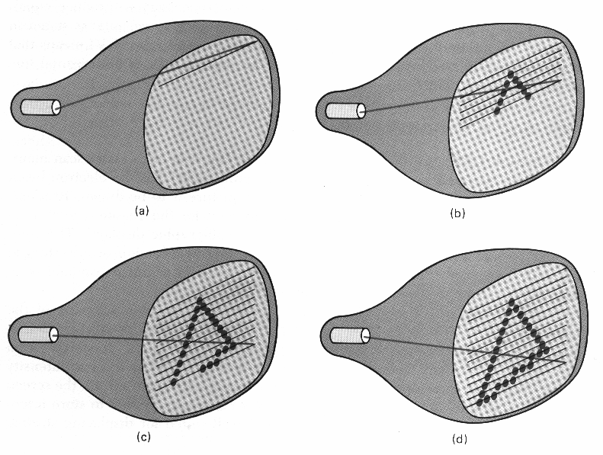

Slide 46
Raster Display Processor
CPU
Peripheral Devices
System Bus
Display Processor
System Memory
Display Processor memory
Frame Buffer
Video Controller
Monitor
Figure: Raster Display Architecture with Display Processor

Slide 47
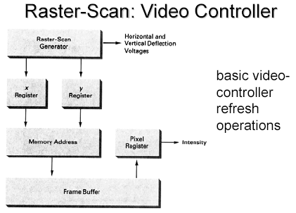
ii. Raster Display Technology

Slide 48
avoids the disadvantage of simple raster display system.
includes a separate graphics processor to perform graphics functions such as scan conversion and raster operation and a separate frame buffer for image refresh.
has its own separate memory called display processor memory that frees the CPU from the graphics chores.
The frame buffer stores displayable image created by scan conversion and raster operations.

Slide 49
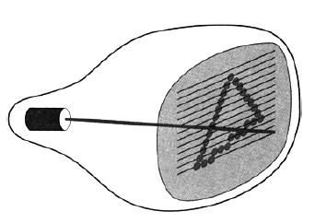
ii. Raster Display Technology

Slide 50
ii. Raster Display Technology
Advantages
It has an ability to fill the areas with solid colors or patterns
The time required for refreshing is independent of the complexity of the image
iii. Low cost

Slide 51
ii. Raster Display Technology
Disadvantages
i. For Real-Time dynamics not only the end points are required to move but all the pixels in between the moved end points have to be scan converted with appropriate algorithms which might slow down the dynamic process
ii. Due to scan conversion “jaggies” or “stair-casing” are unavoidable

Slide 52
RDT/VDT

Slide 53
Frame Buffer
0 0 0 0 0 0 0 0 0 0 0 1 0 0 0 0 0 0 0 0
0 0 1 0 0 0 0 0 0 0
0 0 0 1 0 0 0 0 0 0
0 0 0 0 1 0 0 0 0 0
Screen
0
Electron
Gun
Frame Buffer

Slide 54
Frame Buffer
0 0 0 0 0 0 0 0 0 1 0 1 0 0 0 0 0 0 0 0
0 0 1 0 0 0 0 0 0 0
0 0 0 1 0 0 0 0 0 0
0 0 0 0 1 0 0 0 0 0
Screen
1
Electron
Gun
Frame Buffer

Slide 55
Frame Buffer
0 0 0 0 0 0 0 0 0 1 0 1 0 0 0 0 0 0 0 0
0 0 1 0 0 0 0 0 0 0
0 0 0 1 0 0 0 0 0 0
0 0 0 0 1 0 0 0 0 0
1
r
Screen
0 0 0 0 0 0 0 0 0 1 0 1 0 0 0 0 0 0 0 0
0 0 1 0 0 0 0 0 0 0
0 0 0 1 0 0 0 0 0 0
0 0 0 0 1 0 0 0 0 0
1
0 0 0 0 0 0 0 0 0 0 0 1 0 0 0 0 0 0 0 0
0 0 1 0 0 0 0 0 0 0
0 0 0 1 0 0 0 0 0 0
0 0 0 0 1 0 0 0 0 0
0
Electron
Guns
Frame Buffer

Slide 56
Frame Buffer
0 0 0 0 0 0 0 0 0 1 0 1 0 0 0 0 0 0 0 0
0 0 1 0 0 0 0 0 0 0
0 0 0 1 0 0 0 0 0 0
0 0 0 0 1 0 0 0 0 0
1
r
Screen
0 0 0 0 0 0 0 0 0 1 0 1 0 0 0 0 0 0 0 0
0 0 1 0 0 0 0 0 0 0
0 0 0 1 0 0 0 0 0 0
0 0 0 0 1 0 0 0 0 0
1
0 0 0 0 0 0 0 0 0 1 0 1 0 0 0 0 0 0 0 0
0 0 1 0 0 0 0 0 0 0
0 0 0 1 0 0 0 0 0 0
0 0 0 0 1 0 0 0 0 0
1
Electron
Guns
Frame Buffer

Slide 57
Frame Buffer
0 0 0 0 0 0 0 0 0 1 0 1 0 0 0 0 0 0 0 0
0 0 1 0 0 0 0 0 0 0
0 0 0 1 0 0 0 0 0 0
0 0 0 0 1 0 0 0 0 0
0 0 0 0 0 0 0 0 0 1 0 1 0 0 0 0 0 0 0 0
0 0 1 0 0 0 0 0 0 0
0 0 0 1 0 0 0 0 0 0
0 0 0 0 1 0 0 0 0 0
0 0 0 0 0 0 0 0 0 1 0 1 0 0 0 0 0 0 0 0
0 0 1 0 0 0 0 0 0 0
0 0 0 1 0 0 0 0 0 0
0 0 0 0 1 0 0 0 0 0
0 0 0 0 0 0 0 0 0 1 0 1 0 0 0 0 0 0 0 0
0 0 1 0 0 0 0 0 0 0
0 0 0 1 0 0 0 0 0 0
0 0 0 0 1 0 0 0 0 0
0 0 0 0 0 0 0 0 0 1 0 1 0 0 0 0 0 0 0 0
0 0 1 0 0 0 0 0 0 0
0 0 0 1 0 0 0 0 0 0
0 0 0 0 1 0 0 0 0 0
0 0 0 0 0 0 0 0 0 1 0 1 0 0 0 0 0 0 0 0
0 0 1 0 0 0 0 0 0 0
0 0 0 1 0 0 0 0 0 0
0 0 0 0 1 0 0 0 0 0
0 0 0 0 0 0 0 0 0 1 0 1 0 0 0 0 0 0 0 0
0 0 1 0 0 0 0 0 0 0
0 0 0 1 0 0 0 0 0 0
0 0 0 0 1 0 0 0 0 0
1 1 1 1 1 1 1 1
Screen
0 0 0 0 0 0 0 0 0 1 0 1 0 0 0 0 0 0 0 0
0 0 1 0 0 0 0 0 0 0
0 0 0 1 0 0 0 0 0 0
0 0 0 0 1 0 0 0 0 0
0 0 0 0 0 0 0 0 0 1 0 1 0 0 0 0 0 0 0 0
0 0 1 0 0 0 0 0 0 0
0 0 0 1 0 0 0 0 0 0
0 0 0 0 1 0 0 0 0 0
0 0 0 0 0 0 0 0 0 1 0 1 0 0 0 0 0 0 0 0
0 0 1 0 0 0 0 0 0 0
0 0 0 1 0 0 0 0 0 0
0 0 0 0 1 0 0 0 0 0
0 0 0 0 0 0 0 0 0 1 0 1 0 0 0 0 0 0 0 0
0 0 1 0 0 0 0 0 0 0
0 0 0 1 0 0 0 0 0 0
0 0 0 0 1 0 0 0 0 0
Electron
Guns
0 0 0 0 0 0 0 0 0 1 0 1 0 0 0 0 0 0 0 0
0 0 1 0 0 0 0 0 0 0
0 0 0 1 0 0 0 0 0 0
0 0 0 0 1 0 0 0 0 0
0 0 0 0 0 0 0 0 0 1 0 1 0 0 0 0 0 0 0 0
0 0 1 0 0 0 0 0 0 0
0 0 0 1 0 0 0 0 0 0
0 0 0 0 1 0 0 0 0 0
1 1 1 1 1 1 1 1
Frame Buffer
0 0 0 0 0 0 0 0 0 0 0 1 0 0 0 0 0 0 0 0
0 0 1 0 0 0 0 0 0 0
0 0 0 1 0 0 0 0 0 0
0 0 0 0 1 0 0 0 0 0
0 0 0 0 0 0 0 0 0 1 0 1 0 0 0 0 0 0 0 0
0 0 1 0 0 0 0 0 0 0
0 0 0 1 0 0 0 0 0 0
0 0 0 0 1 0 0 0 0 0
0 0 0 0 0 0 0 0 0 1 0 1 0 0 0 0 0 0 0 0
0 0 1 0 0 0 0 0 0 0
0 0 0 1 0 0 0 0 0 0
0 0 0 0 1 0 0 0 0 0
0 0 0 0 0 0 0 0 0 1 0 1 0 0 0 0 0 0 0 0
0 0 1 0 0 0 0 0 0 0
0 0 0 1 0 0 0 0 0 0
0 0 0 0 1 0 0 0 0 0
0 0 0 0 0 0 0 0 0 1 0 1 0 0 0 0 0 0 0 0
0 0 1 0 0 0 0 0 0 0
0 0 0 1 0 0 0 0 0 0
0 0 0 0 1 0 0 0 0 0
0 0 0 0 0 0 0 0 0 1 0 1 0 0 0 0 0 0 0 0
0 0 1 0 0 0 0 0 0 0
0 0 0 1 0 0 0 0 0 0
0 0 0 0 1 0 0 0 0 0
1 1 1 1 1 1 1 1

Slide 59
Frame Buffer Calculation
For example:
If resolution of a display is 1024*1024
24 bits are included for each pixel.
i.e. 8 bits for RED, 8 bits for GREEN,
Frame buffer require = (1024*1024*24) bits
= (1024*1024*24)/8 bytes
= (1024*1024*24)/(8*1024*1024) Mega bytes
=3 MB

Slide 62
Display device
Cathode Ray Tube (CRT)
Monochromatic CRT
Color CRT
Beam penetration
Shadow mask
Delta- Delta shadow mask
Precision in line CRT

Slide 63
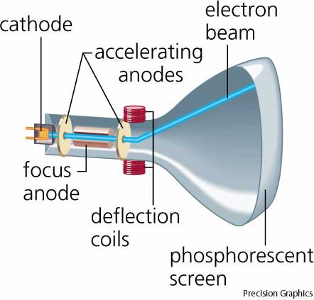
Monochromatic CRT

Slide 64
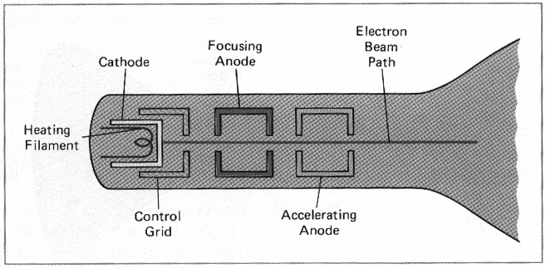


Slide 65
Electron Gun
Heat is supplied to the cathode by the filament.
Intensity of the electron beam is controlled by setting voltage level on the control grid.
A smaller negative voltage on the control grid simply decrease the number of electrons passing through and a higher negative voltage on the control grid increase the number of electrons passing through.

Slide 66
The distance that the electron beam must travel to different points on the screen varies because the radius of curvature for most CRTs is greater than the distance from the focusing system to the screen center.
The electron beam will be focused properly only at the center of the screen.
As the beam moves to the outer edges of the screen, displayed images become blurred.

Slide 67
Deflection of the electron beam can be controlled either with electric fields or with magnetic fields.
Horizontal deflection is accomplished with one pair of coils, and vertical deflection by the other pairs.
Electrostatic deflection: Two pairs of parallel plates are mounted inside the CRT envelope.
Magnetic deflection: Two pairs of coils are used, with the coils in each pair mounted on opposite sides of the neck of the CRT envelope.

Slide 68
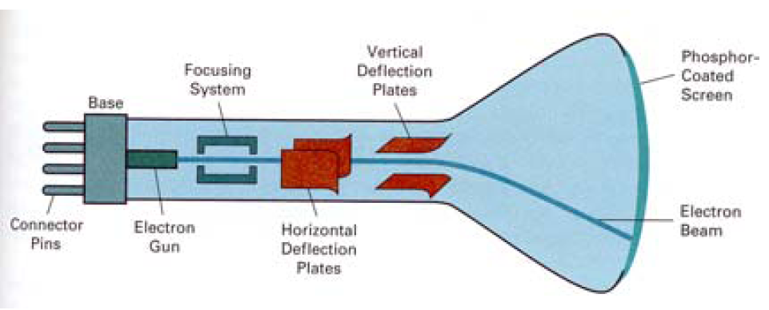
One pair of plates is mounted horizontally to control the vertical deflection, and the other pair is mounted vertically to control horizontal deflection.

Slide 69
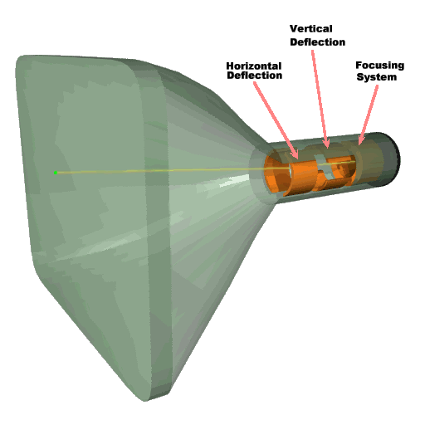
Magnetic deflection

Slide 70
Display Devices
Color CRTs
Color depends on the light emitted by phosphor.
Two type:
Beam Penetration Method
Shadow Mask Method

Slide 71
Display Devices
i. Beam Penetration Method:
Two different layers of phosphor coating used Red (outer) and Green (inner)
Display of color depends on the depth of penetration of the electron beam into the phosphor layers
A beam of slow electrons excites only the outer red layer
A beam of very fast electrons penetrates thru the red phosphor and excites the inner green layer
When quantity of red is more than green then color appears as orange
When quantity of green is more than red then color appears as yellow
Screen color is controlled by the beam acceleration voltage.
Only four colors possible, poor picture quality

Slide 72
Display Devices
ii. Shadow Mask Method
The inner side of the viewing surface of a color CRT consists of closely spaced groups of red, green and blue phosphor dots.
Each group is called a triad
A thin metal plate perforated with many small holes is mounted close to the inner side of the viewing surface. This plate is called shadow mask
The shadow mask is mounted in such a way that each hole is correctly aligned with a triad in color CRT

Slide 73
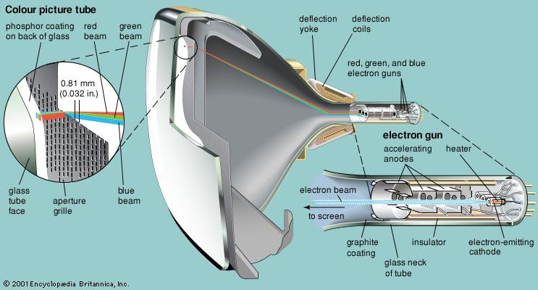
Color CRT

Slide 74
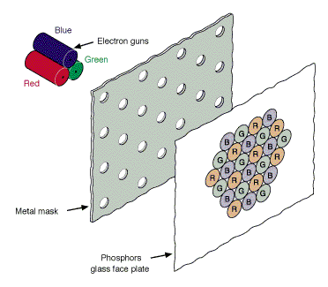
Display Devices
There are three electron guns one for each dot in a triad
The electron beam form each gun therefore hits only the corresponding dot of a triad as the three electron beams deflect
A triad is so small that light emanating from the individual dots is perceived by the viewer as a mixture of the three colors
Thus, a wide range of colors can be produced by each triad depending on how strongly each individual phosphor dot in a triad is excited.

Slide 75
Display Devices
a. A Delta –Delta CRT
A triad has a triangular (delta) pattern as are the three electron guns.
Main drawback of this type of CRT is that a high precision display is very difficult to achieve because of technical difficulties involved in the alignment of shadow mask holes and the triad on one to one basis
b. Precision Inline CRT
A triad has an in-line pattern as are the three electron guns
The introduction of this type of CRT has eliminated the main drawback of a Delta-Delta CRT
But a slight reduction of image sharpness at the edges of the tube has been noticed
Normally 1000 scan lines can be achieved

Slide 76
Delta-Delta CRT

Slide 77
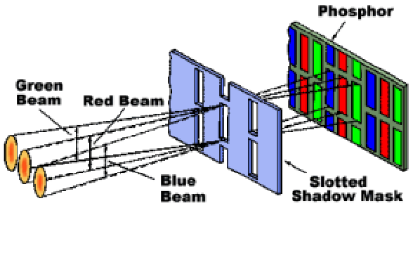
In-line Precision Method

Slide 78
Quality of a CRT Monitor
Depends largely on its resolution, dot pitch, and refresh rate
Resolution describes the sharpness and clearness of an image
Manufacturers state the resolution of a monitor in pixel
Example: 800 X 600
A pixel (picture element) is a single point in an electronic image
A pixel is the smallest element in an electronic image

Slide 79
Video Cards and CRT Monitors
Many CRT monitors use an analog signal to produce an image
Video card converts digital output from the computer into an analog video signal and sends the signal through a cable to the monitor
Also called a graphics card

Slide 80
Video Cards and CRT Monitors
The number of colors a video card displays is determined by its bit depth
The video card’s bit depth, also called the color depth, is the number of bits it uses to store information about each pixel
i.e. 8-bit video card uses 8 bits to store information about each pixel; this video card can display 256 colors (2x2x2x2x2x2x2x2)
i.e. 24-bit video card uses 24 bits to store information about each pixel and can display 16.7 million colors
The greater the number of bits, the better the resulting image

Slide 81
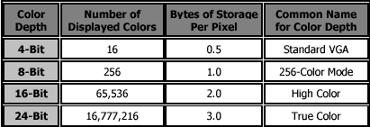

Slide 82
Flat Panel Display
means reduction of volume, weight and power requirements compared to a CRT.
A current applications are calculators, laptops computers, etc.
Two types:
Emissive Displays:
converts electrical energy into light. E.g.: plasma panel, electro luminescent display, etc.
Non-Emissive Display:
uses optical effects to converts sunlight or other light sources into graphical patterns. E.g.: LCD

Slide 83
Plasma Panel Display
consists of matrix of cells in a glass envelope.
Each cell is filled with gas usually neon, xenon, and other inert gases.
the cells are luminous when they are electrified through "electrodes”
With a sufficiently high voltage, some of the atoms in the gas of a cell lose electrons and become ionized creating an electrically conducting plasma of atoms, free electrons, and ions.

Slide 84
The collisions of the flowing electrons in the plasma with the inert gas atoms leads to light emission; such light-emitting plasmas are known as glow discharges.
To turn on a bulb, system adjusts voltages on the corresponding lines.
Once a glow discharge starts, it can be maintained by applying a low-level voltage between all the horizontal and vertical electrodes–even after the ionizing voltage is removed.

Slide 85
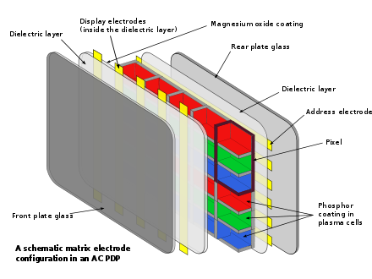

Slide 86
Electro Luminescent Display
It consists of same grid line structure as used in plasma display.
Between front and back panels is a thin layer of electro luminescent material such as zinc sulphide doped with manganese that emits light when a light electric field is applied.
Electrical energy is absorbed by a manganese atom which then release energy as a spot of light similar to the glowing plasma effect in the plasma panel.

Slide 87
Liquid Crystal Display (LCD)
Liquid Crystal has a crystalline arrangement of molecules, get they flow like liquids.
Two glass plated sandwiched the liquid crystal material.
Rows of horizontal transparent conductors are built into one glass plate.
Columns of vertical transparent conductors are put into the other plate.

Slide 88
The intersection of two conductors defines the pixel position.
Polarized light passing through the material is twisted so that it will pass through the opposite polarizer.
The light is then reflected back to the viewer.
This type of device is called passive matrix LCD .
When we use transistors at each pixel position, it is called as active matrix displays. E.g. TFT (Thin Film Transistor) LCD

Slide 89
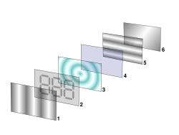
Polarizing filter film with a vertical axis to polarize light as it enters.
Glass substrate with electrodes with vertical ridges.
Twisted nematic liquid crystal.
Glass substrate with common electrode film with horizontal ridges to line up with the horizontal filter.
Polarizing filter film with a horizontal axis to block/pass light.
Reflective surface to send light back to viewer.

Slide 90
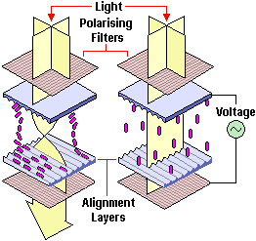
Off State
On State

Slide 91
